Slide 1

Finding And Keeping a Job with ChatGPT Plus
Use AI to Your Advantage
And then Some
Notes:
https://careerservices.upenn.edu/preparing-effective-resumes/undergraduates-student-resume-samples/

Slide 2
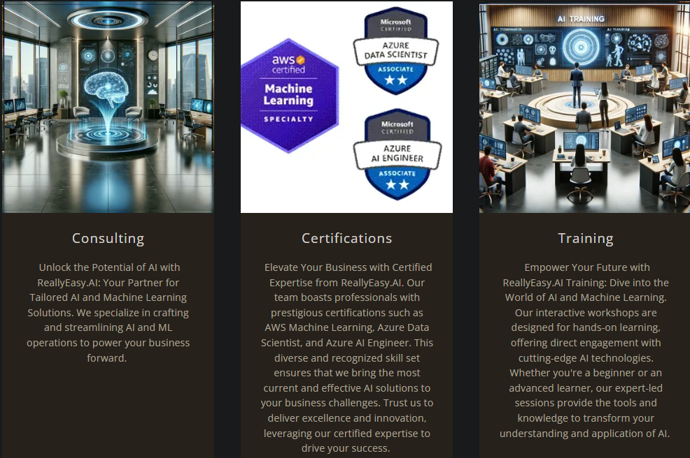

Slide 3

1.0 Mechanization, Steam, and Water Power
2.0 Mass Production and Electricity
3.0 Electronic / IT Systems and Automation
4.0 Cyber Physical Systems and
Artificial Intelligence
Notes:
https://www.forbes.com/sites/forbescoachescouncil/2023/10/30/generative-agile-leadership-what-the-fourth-industrial-revolution-needs/

Slide 4
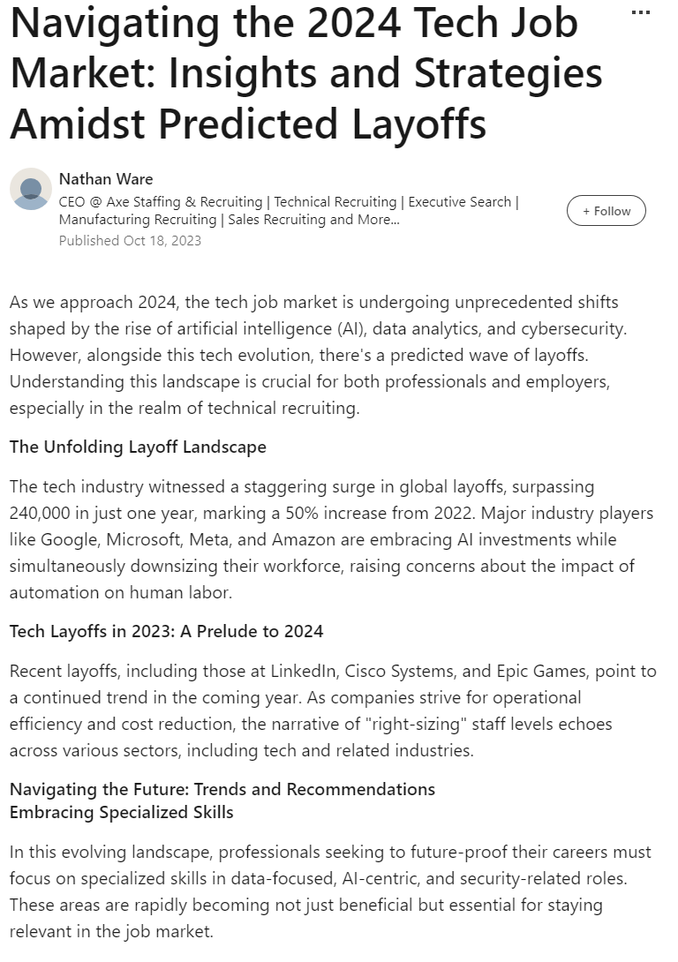
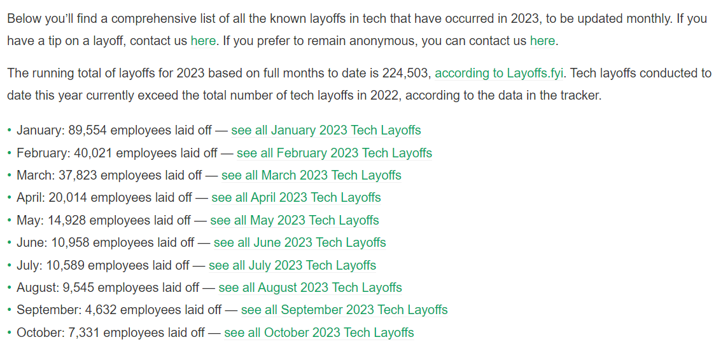
The Tech Job Market is Brutal Right Now
Notes:
https://www.linkedin.com/pulse/navigating-2024-tech-job-market-insights-strategies-amidst-ware

Slide 5
"Some people can read 'War and Peace' and come away thinking it's a simple adventure story.
Others can read the ingredients on a chewing gum wrapper and unlock the secrets of the universe."
Gene Hackman as Lex Luthor - Superman the Movie (1978)
Notes:
https://en.wikipedia.org/wiki/Superman_(1978_film)

Slide 6
ChatGPT Plus
Your first Chewing gum wrapper

Slide 7
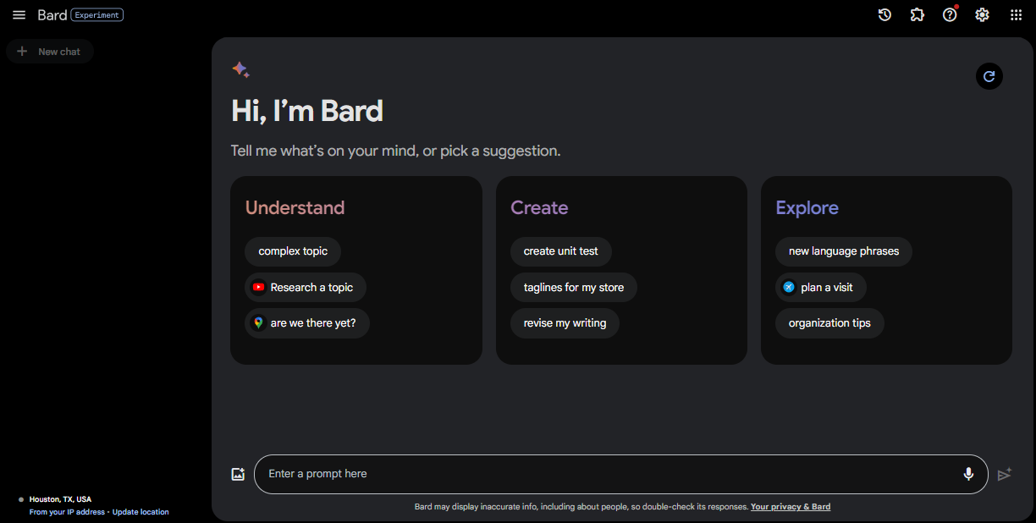
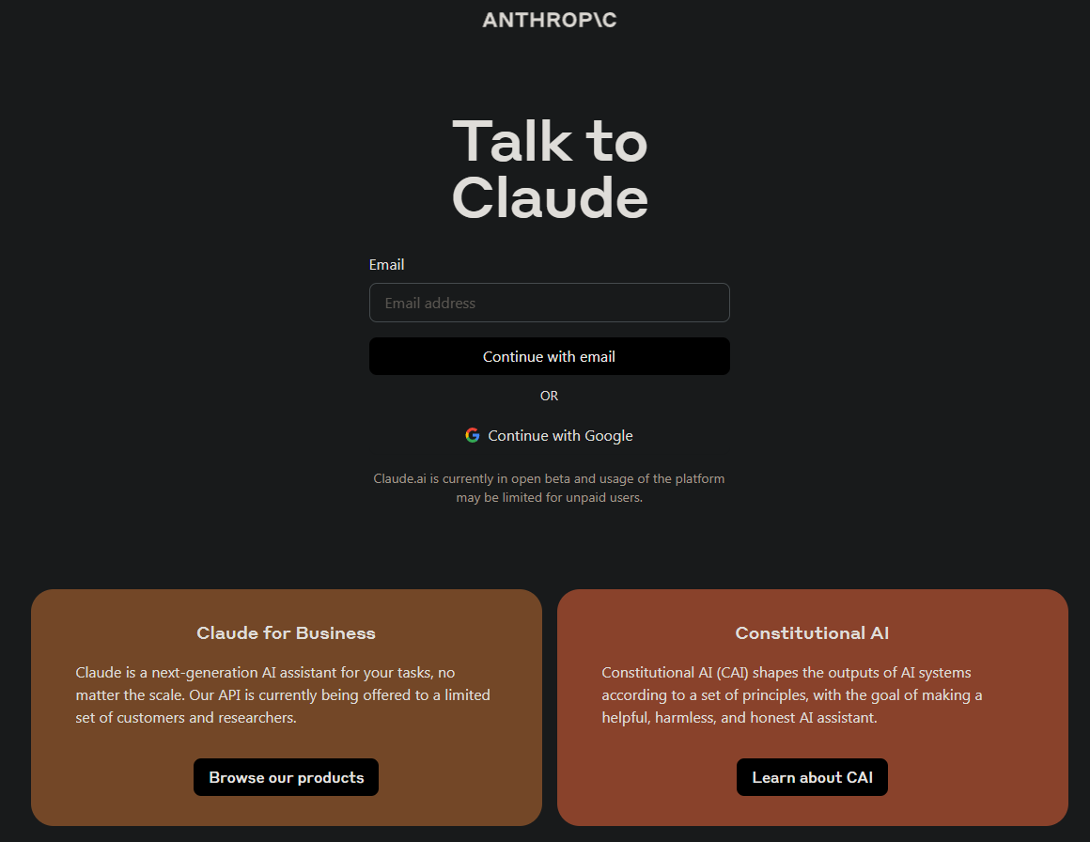
Not The Only Game in Town
Notes:
https://bard.google.com/chat
https://claude.ai/login

Slide 8
Why ChatGPT?
Easy to use
The de facto leader in the chat space
Low barrier to entry (Free)
Packed with features (especially Plus)
Widely known, recognized skill (Prompt Engineering)

Slide 9
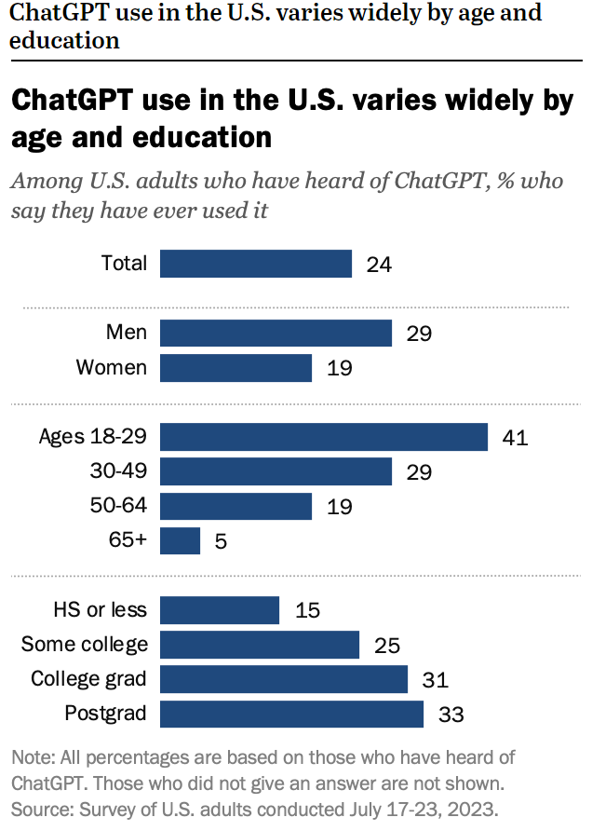
Notes:
https://www.pewresearch.org/short-reads/2023/08/28/most-americans-havent-used-chatgpt-few-think-it-will-have-a-major-impact-on-their-job/

Slide 10
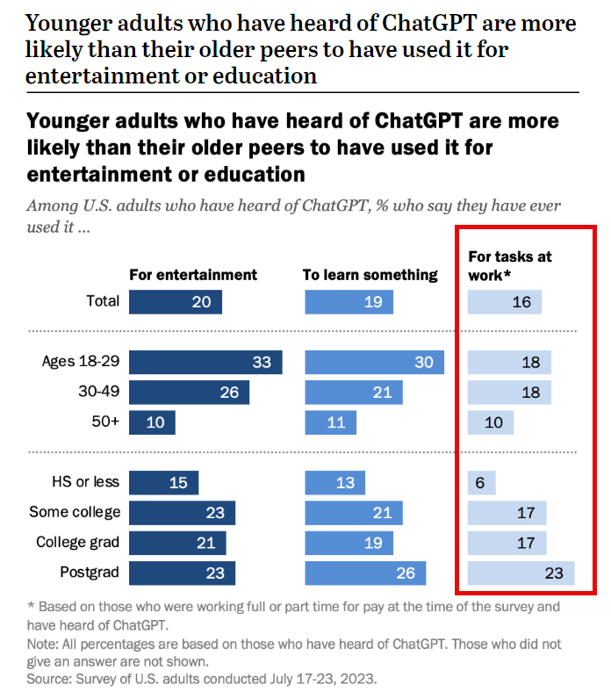
Notes:
https://www.pewresearch.org/short-reads/2023/08/28/most-americans-havent-used-chatgpt-few-think-it-will-have-a-major-impact-on-their-job/

Slide 11
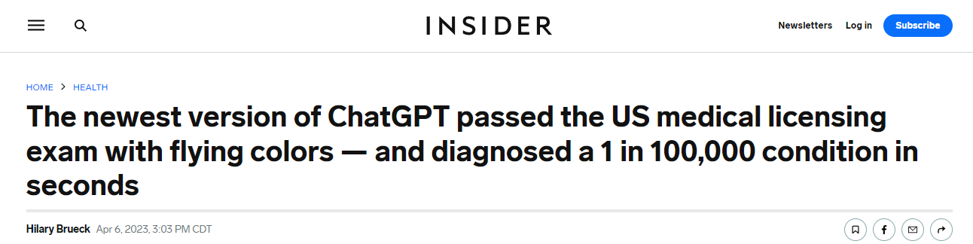
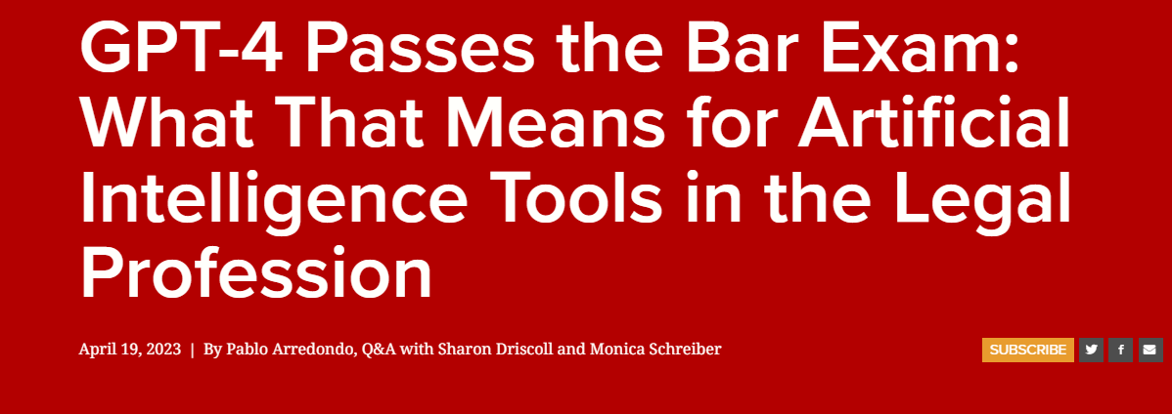
Notes:
https://www.insider.com/chatgpt-passes-medical-exam-diagnoses-rare-condition-2023-4
https://law.stanford.edu/2023/04/19/gpt-4-passes-the-bar-exam-what-that-means-for-artificial-intelligence-tools-in-the-legal-industry/

Slide 12
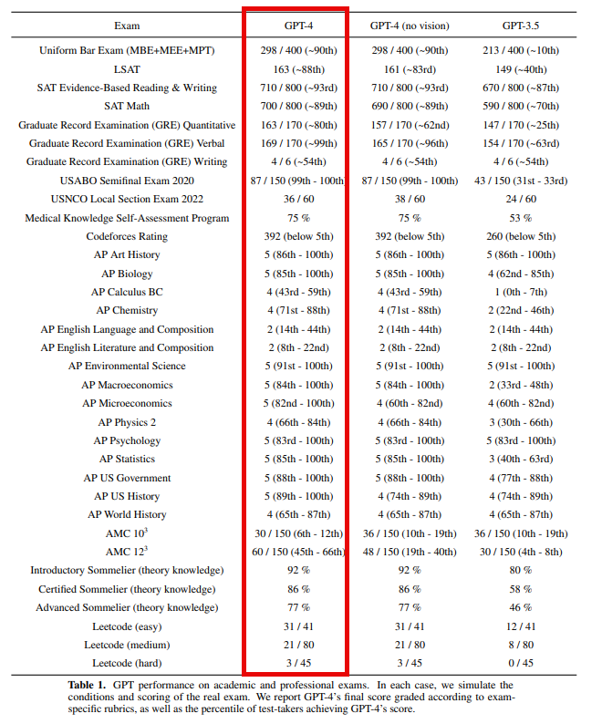
Notes:
https://cdn.openai.com/papers/gpt-4.pdf

Slide 13
Use the website, Get the mobile App
Website - https://chat.openai.com/
Mobile
Android - https://play.google.com/store/apps/details?id=com.openai.chatgpt&hl=en_US&gl=US&pli=1
iPhone - https://apps.apple.com/us/app/chatgpt/id6448311069

Slide 14
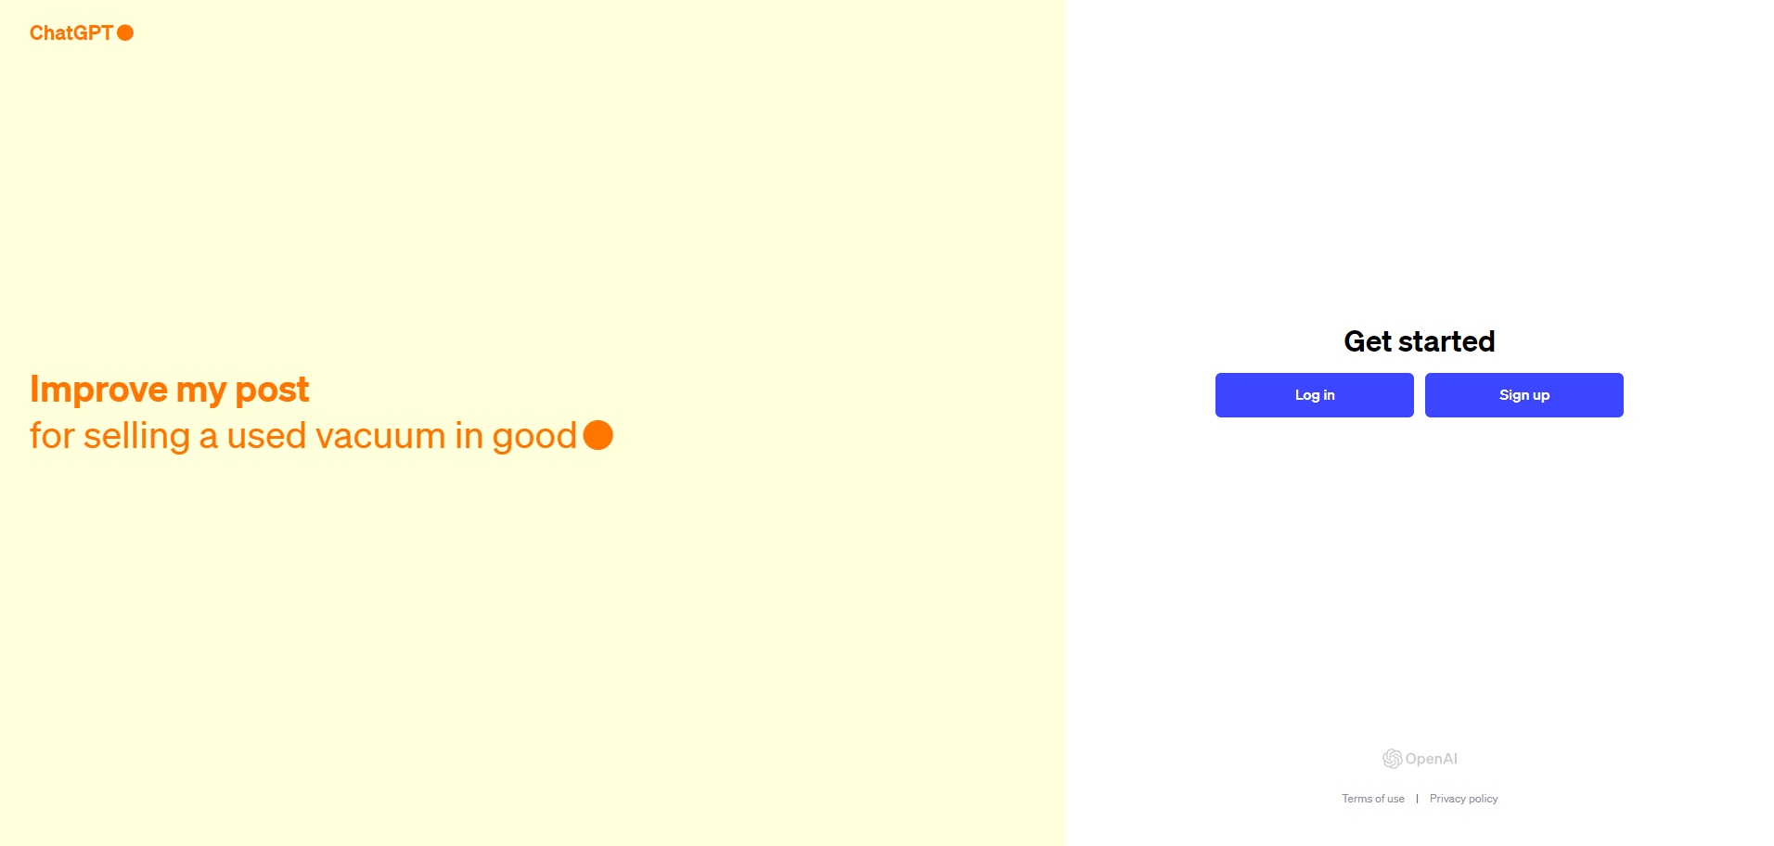
Signing Up for ChatGPT

Slide 15
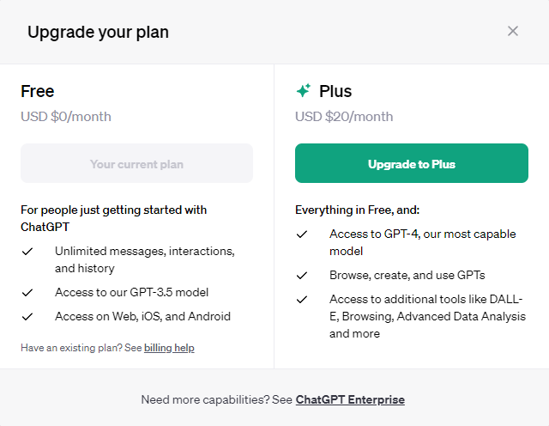
Upgrading

Slide 16
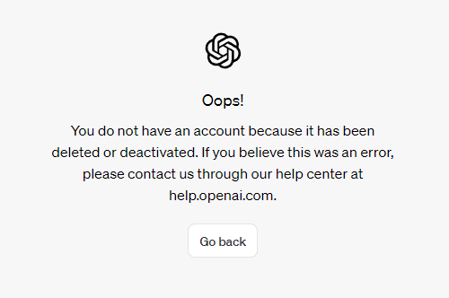
Never, Ever, Ever Delete Your Account Downgrade Instead

Slide 17
Using ChatGPT Plus to Find, Get, and Keep a Job
Make the Most of Your AI Time Investment

Slide 18

Personas
Making Sure You Have the Right Expert

Slide 19
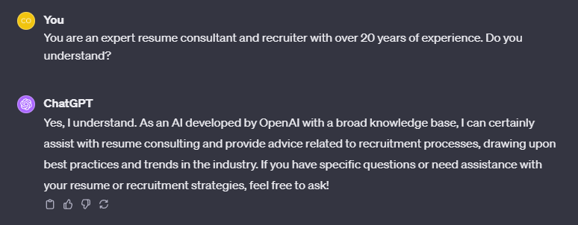
Personas
Notes:
https://platform.openai.com/docs/guides/gpt-best-practices/tactic-ask-the-model-to-adopt-a-persona
https://arxiv.org/pdf/2302.11382.pdf

Slide 20
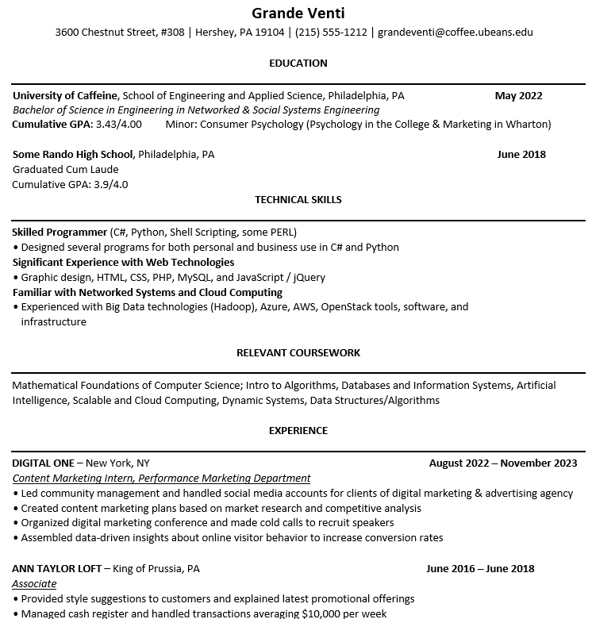
Grande Venti

Slide 21
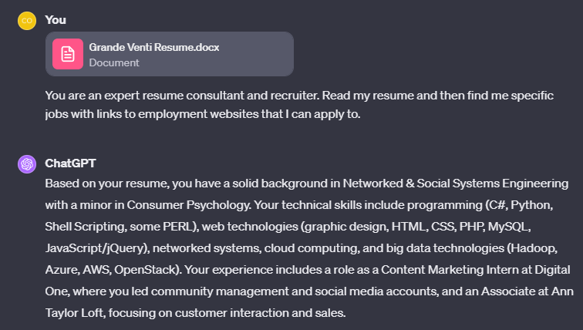
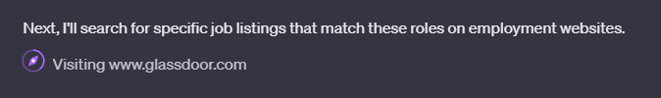
Finding a Job

Slide 22

Resume Advice
Make Sure Your Resume is Up To Speed

Slide 23
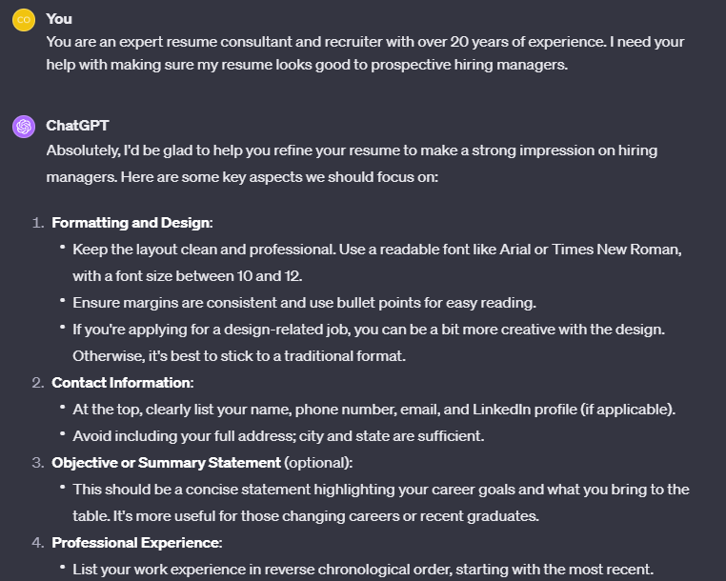
Resume Advice

Slide 24

Cover Letters
Never, Ever Apply without a Cover Letter

Slide 25
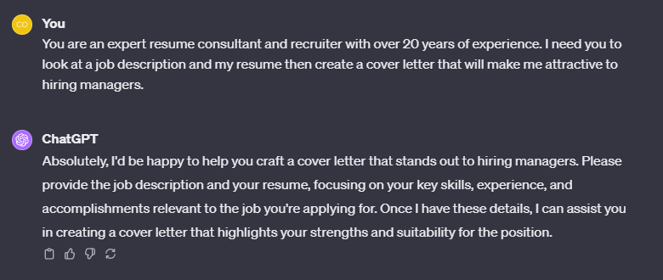
Cover Letters

Slide 26

Portfolio Building
Show Off Your Skills

Slide 27
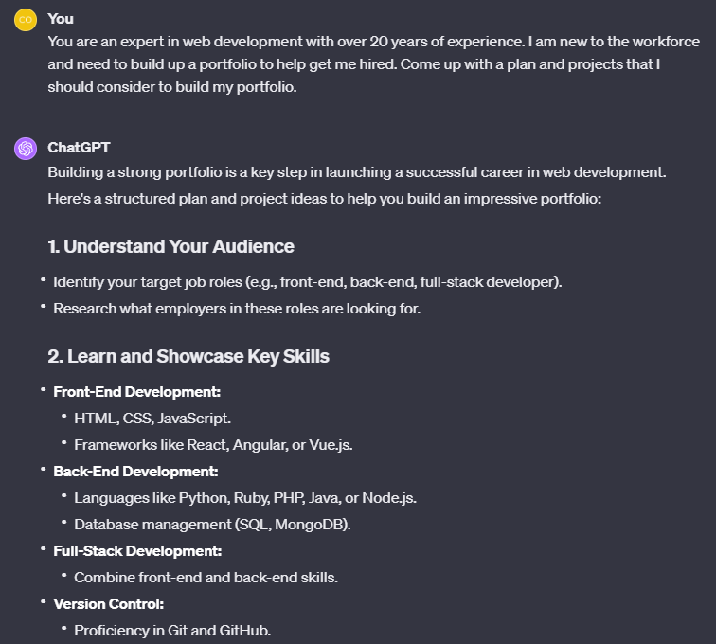
Portfolio Building

Slide 28

Interview Prep
Ace the Interview with AI

Slide 29
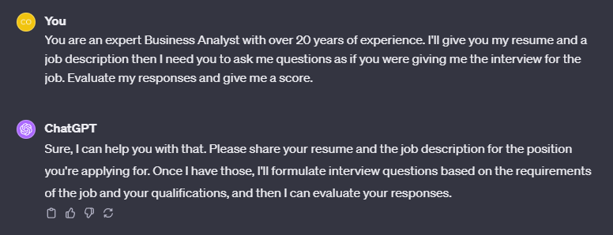
Interview Prep

Slide 30

On The Job
AI Doesn’t End Once You Get the Job

Slide 31
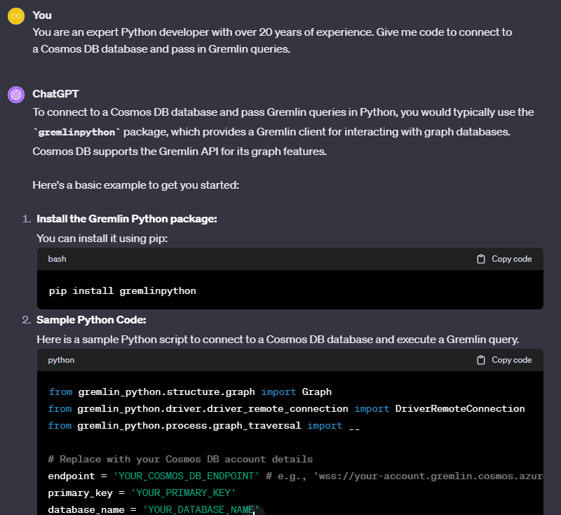
On the Job Tech

Slide 32
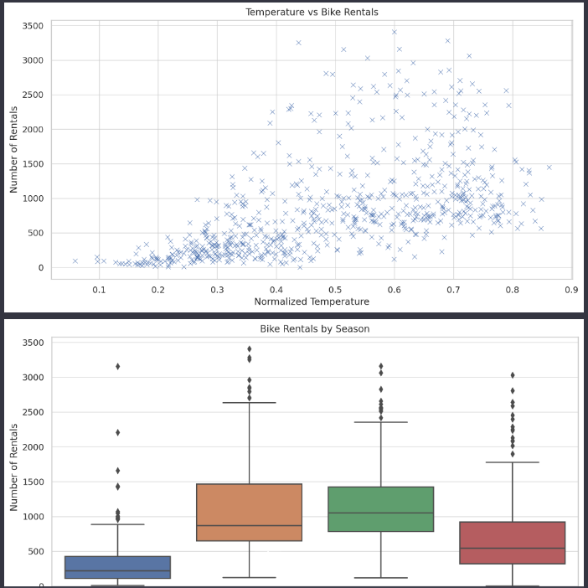
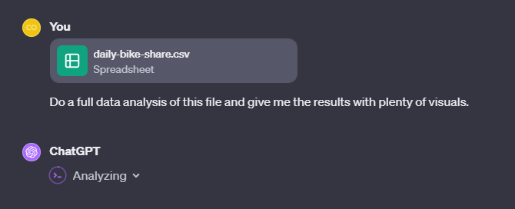
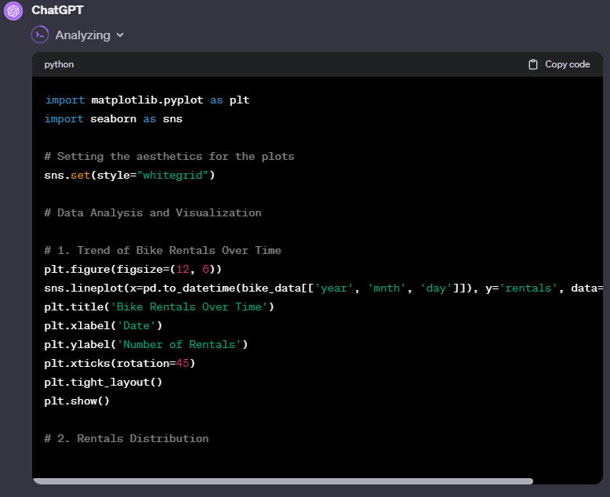
On the Job Data Analysis

Slide 33
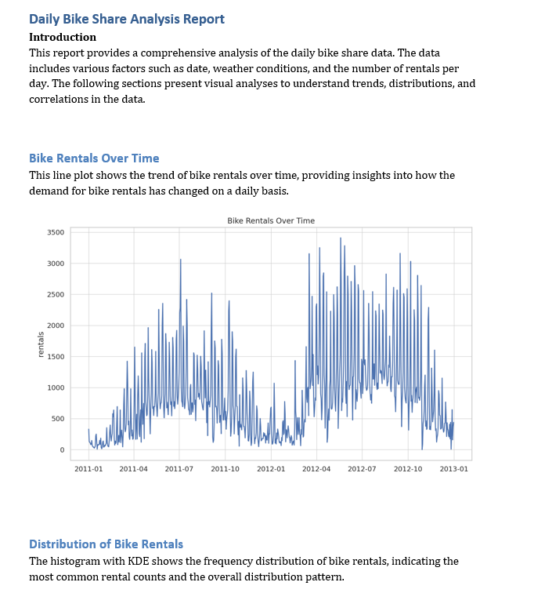
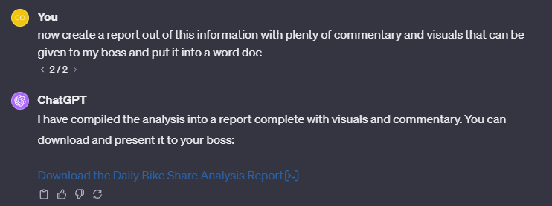
On the Job Reports

Slide 34

Understanding Difficult Concepts
Getting Your Head around a Subject

Slide 35
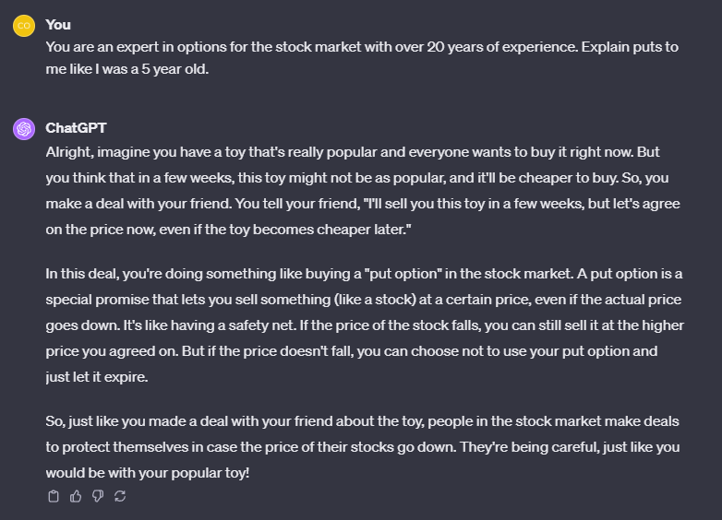
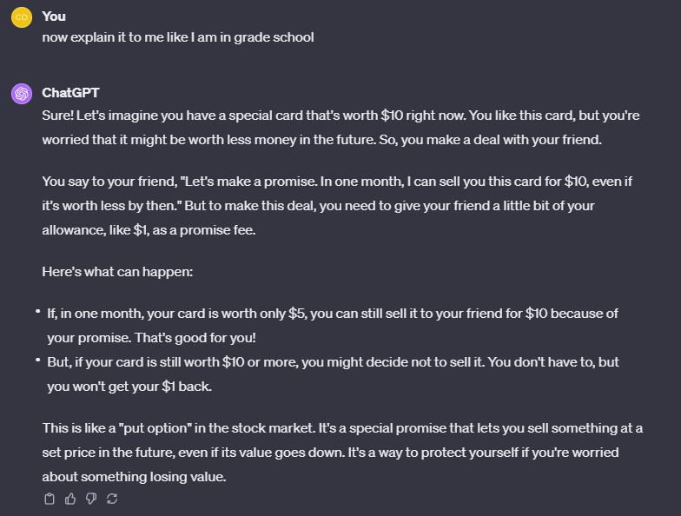
Understanding Difficult Concepts

Slide 36

Notes:
Good luck out there! You can do it!

